Slide 1
Water Treatment Plant Project
Presented by: Stick Vision India Pvt. Ltd.
Owner: Aditya Singh Rajput
Total Cost: ₹700 Crore

Slide 2
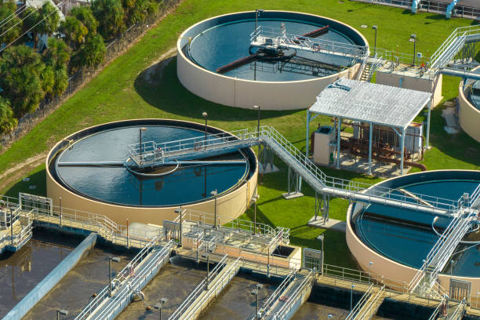
Introduction & Importance
Ensures safe and clean drinking water
Prevents waterborne diseases
Supports agriculture & industry
Maintains environmental balance

Slide 3


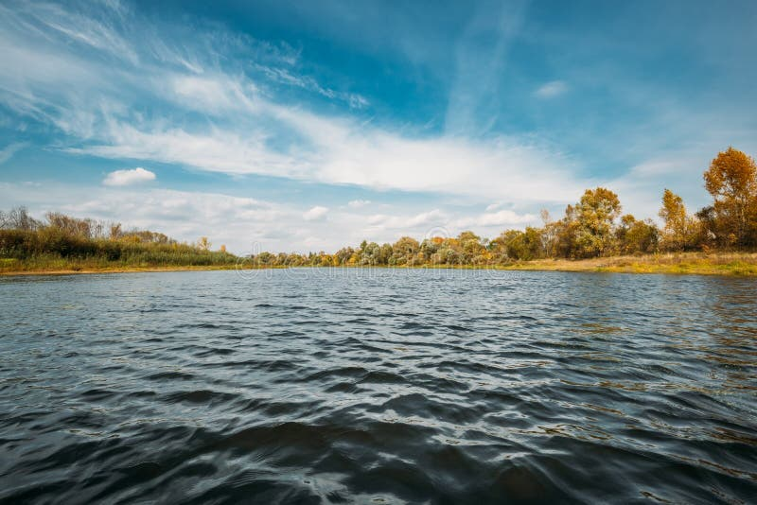
Source of Raw Water
Rivers
Lakes
Groundwater
Rainwater harvesting

Slide 4
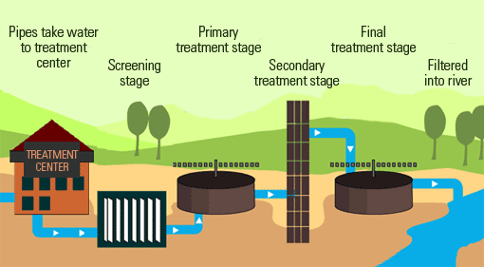
Stages of Water Treatment
1. Screening
2. Sedimentation
3. Coagulation & Flocculation
4. Filtration
5. Desalination
6. Disinfection

Slide 5
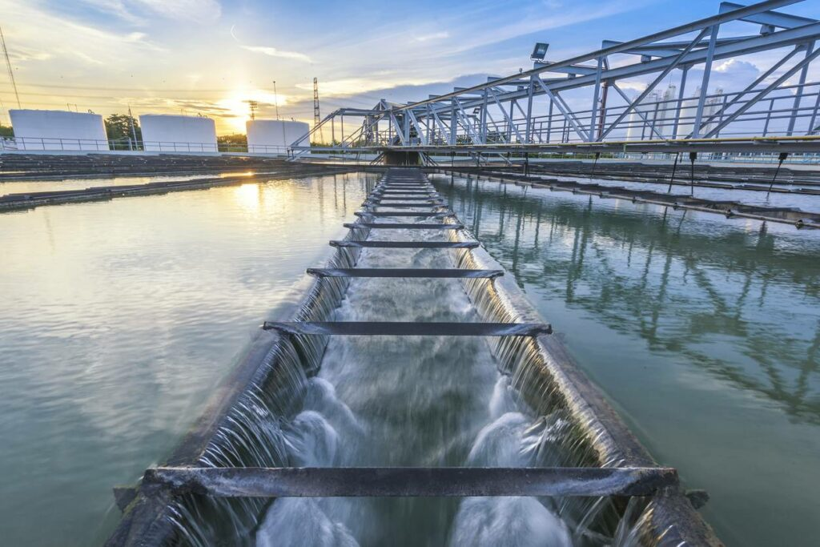
Screening Process
Removes large debris
Initial filtration
Mesh screens used

Slide 6
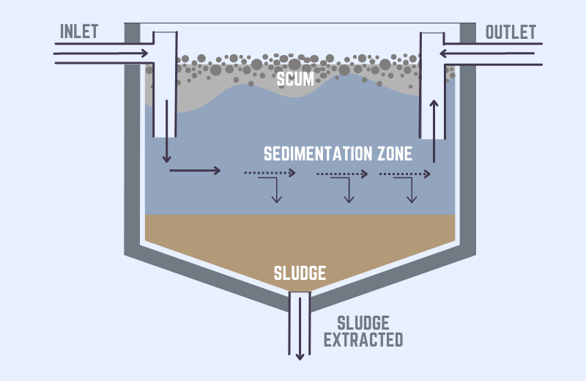
Sedimentation
Settles heavy particles
Gravity-based tanks

Slide 7
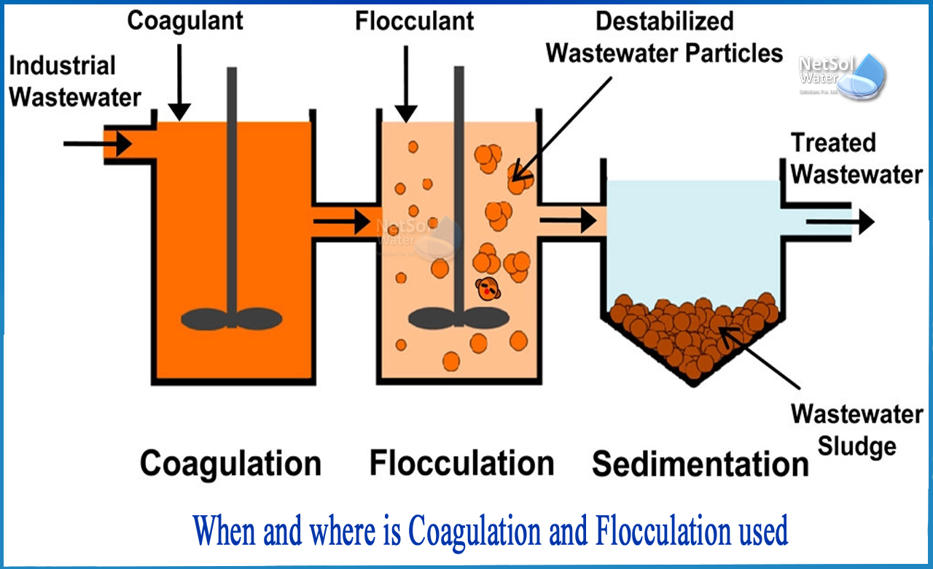
Coagulation & Flocculation
Coagulants added (e.g., Alum)
Forms flocs for easier removal

Slide 8
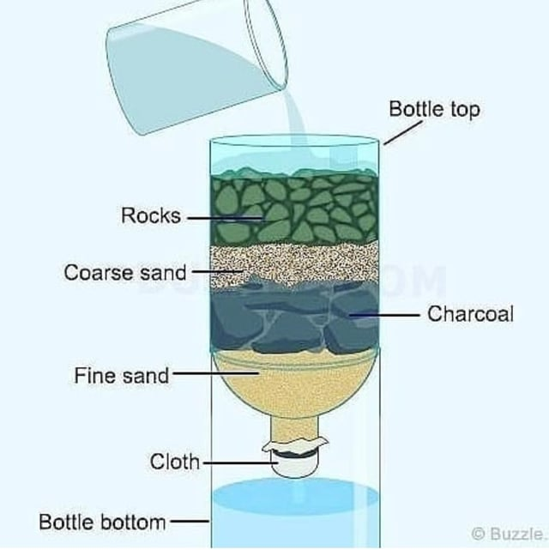
Filtration
Sand, gravel & carbon filters
Removes fine particles

Slide 9
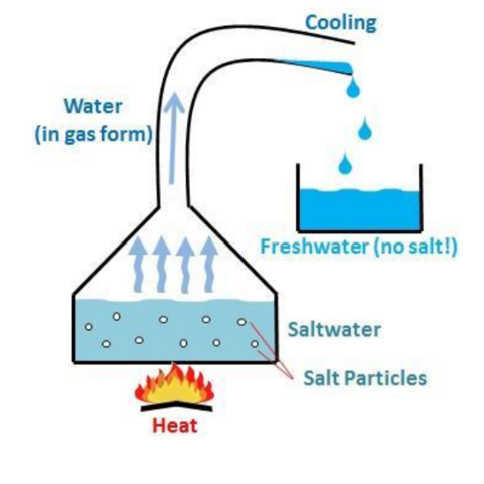
Desalination
Removes salt from seawater
Reverse osmosis process

Slide 10
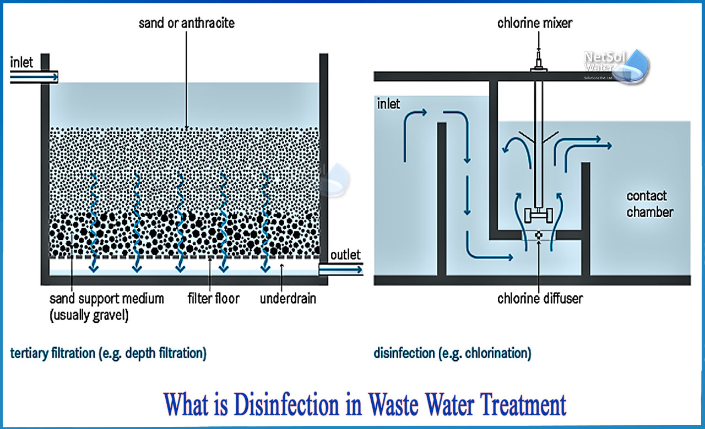
Disinfection
Chlorination, UV & ozone
Kills harmful microbes

Slide 11
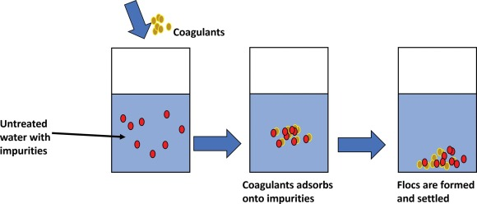
Chemical Usage
Chlorine
Alum
Ozone
Fluoride (if required)

Slide 12
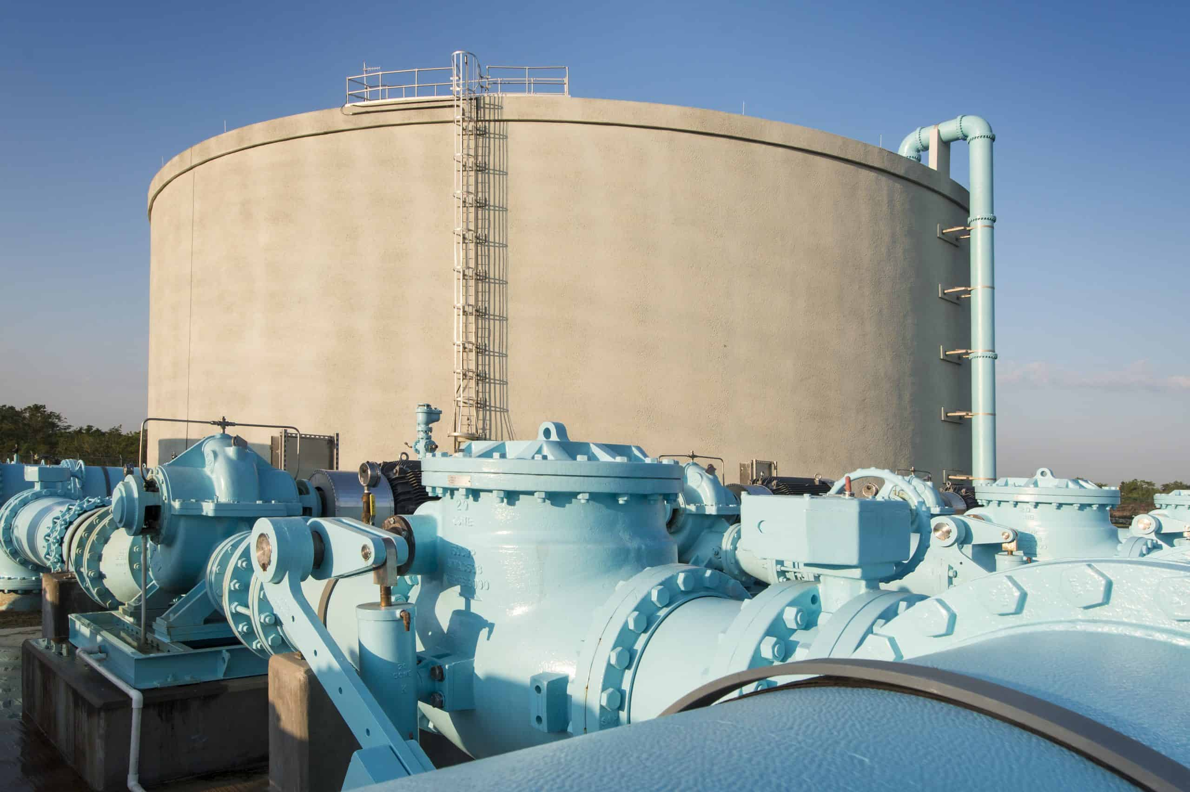
Storage & Distribution
Clean water tanks
Pipe distribution networks
24/7 supply system

Slide 13
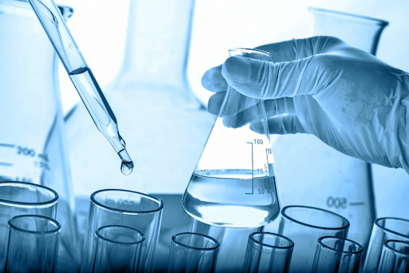
Quality Control
Real-time water testing
AI-based quality alerts
ISO-certified labs

Slide 14
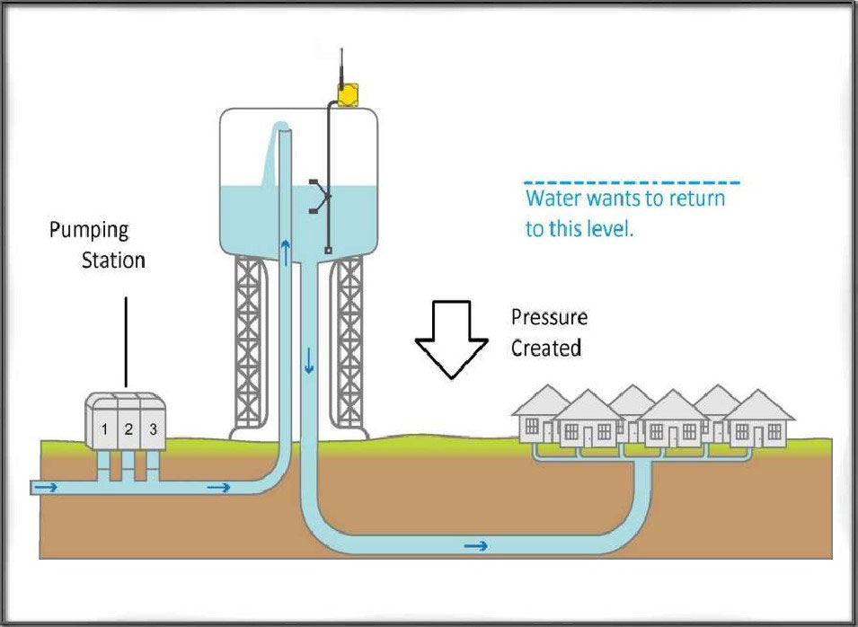
Distribution Process
Pump stations
Pressure maintenance
Leak detection systems

Slide 15
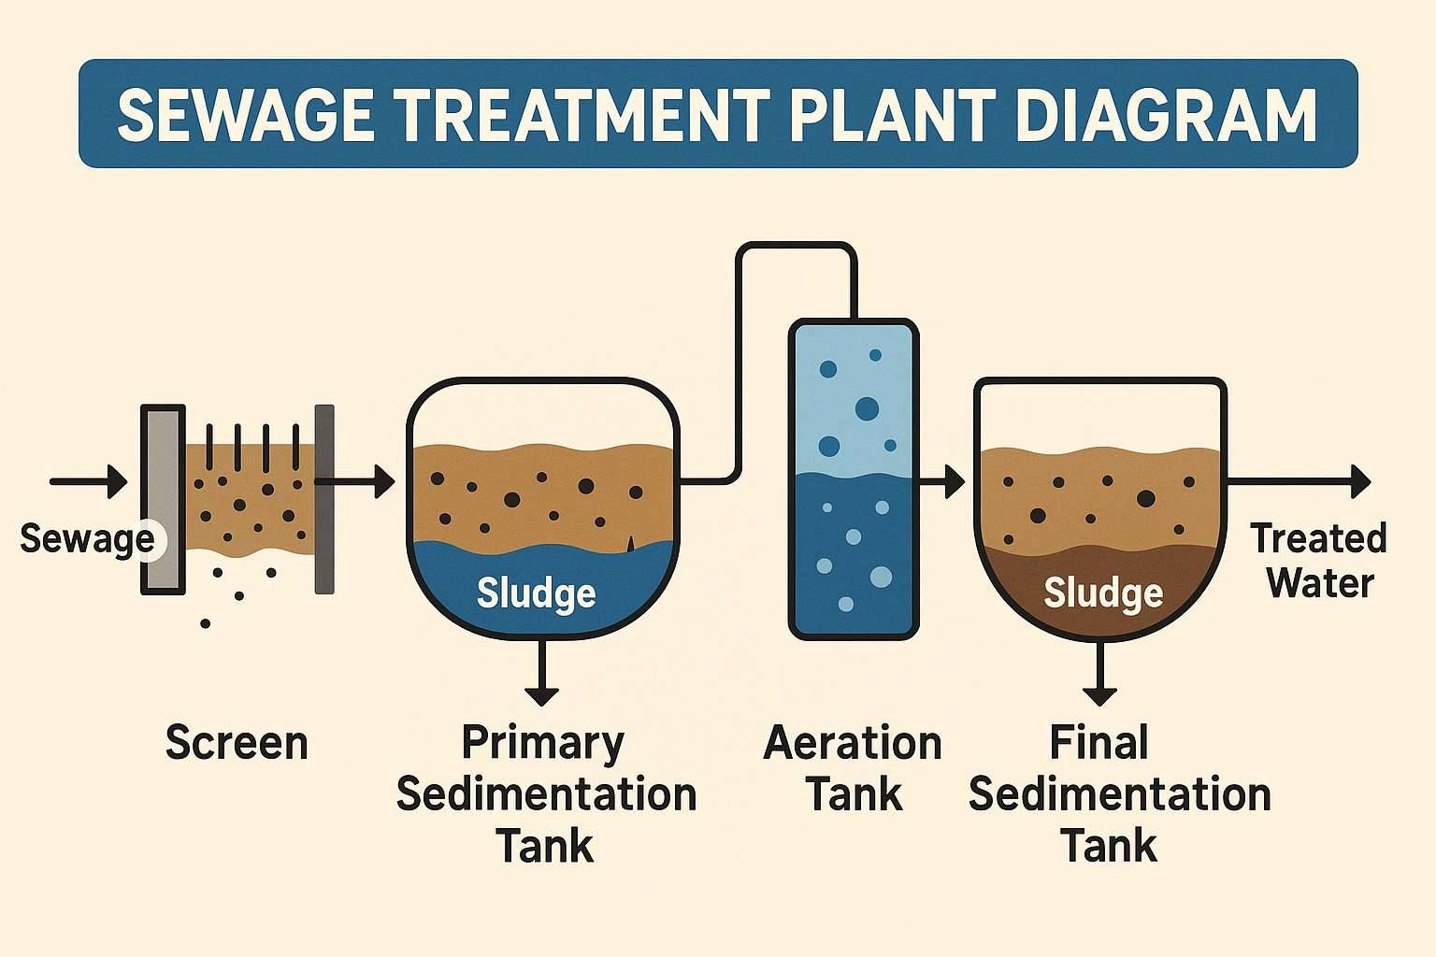
Waste Water Disposal
Treated before discharge
Used for irrigation & cleaning
Sludge converted to biofuel

Slide 16
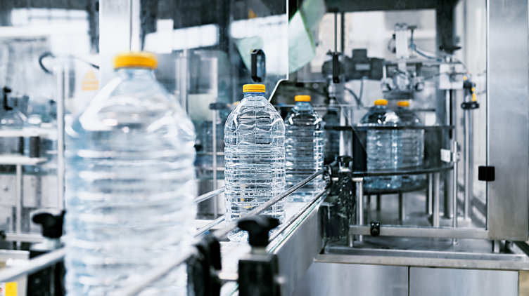
Safety & Automation
Fully automated monitoring
IoT & sensors installed
Emergency alert systems

Slide 17

Team & Facilities
Total Staff: 2000
Engineers: 20
Scientists: 20
Doctors: 24/7 on board
Medical Camp: Available on ship

Slide 18
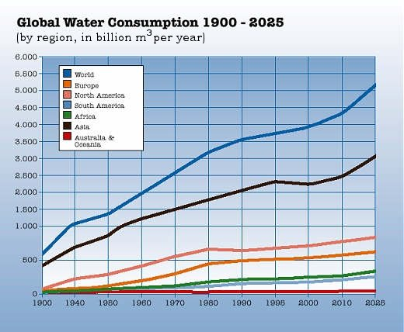
Cost of Water – Global Comparison
1 Liter Water = ₹1000 in India
America – ₹3500
Singapore – ₹3000
China – ₹900
Russia – ₹750
Brazil – ₹850
Canada – ₹3200
Australia – ₹2800
Japan – ₹3100
Mexico – ₹880
France – ₹3300

Slide 19
Total Project Summary
₹700 Cr investment
Eco-friendly & smart plant
Round-the-clock support
International safety standards
Public & government collaboration

Slide 20
Thank You / Launch Info
COMPANY OWNER : Aditya Singh Rajput
PROJECT COST : 700CR
PROJECT LOUNCHED : Stick Vision India Pvt Ltd
WORK COLABORATION : we launched our water project in different country with the help of dubai government.

